Slide 1
Supply Chain Optimization
Presenter Name
Notes:
Information in this document, including URL and other Internet Web site references, is subject to change without notice. Unless otherwise noted, the example companies, organizations, products, domain names, e-mail addresses, logos, people, places, and events depicted herein are fictitious, and no association with any real company, organization, product, domain name, e-mail address, logo, person, place or event is intended or should be inferred. Complying with all applicable copyright laws is the responsibility of the user. Without limiting the rights under copyright, no part of this document may be reproduced, stored in or introduced into a retrieval system, or transmitted in any form or by any means (electronic, mechanical, photocopying, recording, or otherwise), or for any purpose, without the express written permission of Microsoft Corporation.
Microsoft may have patents, patent applications, trademarks, copyrights, or other intellectual property rights covering subject matter in this document. Except as expressly provided in any written license agreement from Microsoft, the furnishing of this document does not give you any license to these patents, trademarks, copyrights, or other intellectual property.
The names of manufacturers, products, or URLs are provided for informational purposes only and Microsoft makes no representations and warranties, either expressed, implied, or statutory, regarding these manufacturers or the use of the products with any Microsoft technologies. The inclusion of a manufacturer or product does not imply endorsement of Microsoft of the manufacturer or product. Links may be provided to third party sites. Such sites are not under the control of Microsoft and Microsoft is not responsible for the contents of any linked site or any link contained in a linked site, or any changes or updates to such sites. Microsoft is not responsible for webcasting or any other form of transmission received from any linked site. Microsoft is providing these links to you only as a convenience, and the inclusion of any link does not imply endorsement of Microsoft of the site or the products contained therein.
© 2017 Microsoft Corporation. All rights reserved.
Microsoft and the trademarks listed at https://www.microsoft.com/en-us/legal/intellectualproperty/Trademarks/Usage/General.aspx are trademarks of the Microsoft group of companies. All other trademarks are property of their respective owners.
August 2020

Slide 2
Abstract and learning objectives
In the whiteboard design session, you will work in groups to design a solution that should provide a vision that allows the audience (the Chief Marketing Officer, Chief Digital Officer, the Chief Data Officer, and the Customer Experience Manager) to understand how using this solution will give the information that is needed to deliver the Supply Chain optimized solution.
At the end of the whiteboard design session, you will be better able to design a solution that leverages various application and data services within Azure for an end-to-end architecture for Supply Chain Optimization.

Slide 3
Step 1: Review the customer case study
Outcome
Analyze your customer needs.
Timeframe
15 minutes

Slide 4
Customer abstract
Parts Unlimited, a subsidiary of Fabrikam Retail INC., has been feeling some pain and would like your help to redesign and implement some new solutions to be able to better compete in the current marketplace. Among the main problems that Parts Unlimited is facing are
* Lack of connection between online and in-store data leading to an inability to provide a selection optimization that is tailored to a specific customer
* Lack of infrastructure to maximize cost savings through correct inventory levels
* Poor last-mile delivery
* Departments operate in silos so they cannot communicate due to disparate data sources.
* Limited visibility of data with no feedback loop on the supply chain.
* Affecting changes to the supply chain is not a trivial endeavor.
* No current 360 degree view of the supply chain.

Slide 5
Customer abstract continued
Parts Unlimited is asking you to build a system that takes all of the supply-chain data and ingests it into IoT and Event Hubs as necessary, then performs analysis on the data.
Key success criteria will include
* Contract Cycle data and optimization
* Available to promise capabilities
* Price-elasticity analysis
* Route planning and scheduling
* Demand forecasting
Included in the analysis and processing will be data from
* Point of sale transactions
* Purchase data from all channels
* Device/Sensor data from IoT devices
* Warehouse logistical and operational data
* Social media sentiment and analysis
The primary goal for this system is to conglomerate all of the data into a single source of truth for use in reporting, bringing together all of the moving pieces from the supply chain.
In the end, your solution should provide a vision that allows the audience (the Chief Marketing Officer, Chief Digital Officer, the Chief Data Officer, and the Customer Experience Manager) to understand how using this solution will give the information that is needed to deliver a 360 degree view of the supply chain.

Slide 6
Customer situation
Parts Unlimited Retail, Inc has been selling goods through various retail channels for the past 15 years. As various platforms and technologies have evolved, Parts Unlimited has struggled to keep up, but has done the best they could to continue to provide solutions for their customers.
Currently, they have just over 200 brick-and-mortar stores but are planning to close 50+ of these stores next year, taking the number of physical locations down to 150 stores due to declining revenue and various other factors. Of the remaining 150 stores, 35 of them are currently streamlined for an attempted re-branding that happened a few years ago. The re-branded stores were chosen based on population bases of less than 50,000 in an 200 square mile radius or within 50 miles of a major metropolitan area. These rebranded "Parts Unlimited Hometown" stores eliminated most of the non-essential retail, such as sporting and workout equipment, and focused in on essentials like appliances, automotive, and kept a limited selection of electronics, only offering about 15% of the options for items like UHD televisions, antennas, and blu-ray players. Customers have expressed frustrations when an advertisement in the local newspaper for Parts Unlimited included a great deal on a large-screen television only to find they have to order online or drive to the larger store in a city that is sometimes located over 50 miles away. While it is clear that customers are not pleased with this solution, it is not clear if this is an effective strategy to save the company when it comes to providing a simplified retail option.

Slide 7
Customer situation continued
In addition to re-branding efforts, in the past few years attempts have been made to enhance the web app for responsive delivery and a couple of apps were also built to specifically target IOS and Android devices. Unfortunately, the data from these applications and the web solution is not connected, and when a user switches devices or goes from a device to the web, the experience is not uniform, leading to confusion and frustration. Questions such as "why isn't the item I selected on my phone in my cart when I go to the website?" are far too common.
Parts Unlimited needs an ability to collect and analyze all of this data in order to make the best uniform solution possible. The final solution from this challenge workshop should provide an ability for Parts Unlimited to take control of their supply chain so that customers can know when and where products are going to be available, and that stores can be prepared to keep up with expected demands.
While there are clearly other issues at play that Parts Unlimited needs to solve, the solution you are creating in this workshop needs to allow for a user to be able to walk into a brick-and-mortar store and get the items they are looking for, and for the stores to have the ability to meet demand based on an optimized supply chain.
This goal of improved ability to meet customer demand will be accomplished by establishing a 360 degree view of the supply chain, with data analysis and reporting that provides the business the ability to plan and schedule deliveries of products according to forecasted needs, based on customer sentiment current buying trends.

Slide 8
Current process
Parts Unlimited currently has over 200 brick-and-mortar stores, with 50+ stores closing and 35 stores running the re-branded profile. Some stores have a pre-determined, limited selection and a limited inventory of the products they do offer.
Parts Unlimited has an MVC website written in the .Net Framework and has been previously upgraded to version 4.72. The website is supposed to be responsive, as it utilized Bootstrap for responsive layout, but the site is currently not able to work on a few devices due to some styling problems.
In addition to the website, Parts Unlimited has an Android application written in native Java that is three versions behind the current version of Android, but has been upgraded enough to continue to work on newer devices, even though it does not necessarily leverage all of the features of newer devices.
Along with the website and android app, a third app written in Swift is available for use on the Apple IOS devices.
All applications and sites do work, but the user experience, including sign-on, shopping cart, and other factors is unique to each platform. For example, a user must sign in on the website and then sign in again on the device, and the shopping cart is not shared across devices, so items added to the cart on the web do not show up on the phone, or vice-versa.

Slide 9
Current process continued
As a struggling retailer, Parts Unlimited has a limited amount of resources to apply to getting the entire experience upgraded, so they need you to come up with the best, cost-effective solution.
When it comes to supply chain management, Parts Unlimited is not very efficient. They currently have five different departments, all siloed, and none of the departments are working together to get to the overall vision that Parts Unlimited needs. This is in addition to separate databases used to track products, orders, and customers for the online and the physical store inventory and ordering systems.
The current reporting systems live on top of four different systems with five total silos. They are as follows:
* SAP for Demand Planning
* SAP for Financials
* Salesforce CRM
* JD Edwards EDI
* Oracle Retail ERP

Slide 10
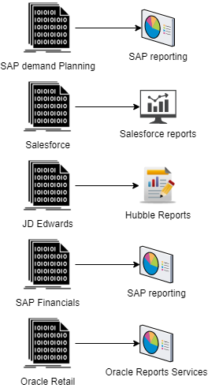
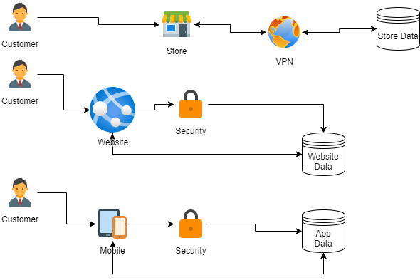
Current Process diagrams

Slide 11
Customer Needs
1. Use Azure data and analytics tools to create a 360 degree view of the supply chain.
2. Ingest data from existing systems as defined, as well as other systems and future implementations (i.e. IoT Devices, Website and app telemetry for customer search and purchase data). Data from point of sale transactions and purchase information should also be ingested.
3. Provide reporting to the business user to be able to make decisions around the contract cycle, delivery scheduling and route planning, and demand forecasting with price-elasticity metrics.
4. Optimize warehouse inventory management and staff utilization to ensure all channels are working with efficiency and no under-staffing or over-staffing according to predicted demands.
5. An optimized last-mile delivery plan to ensure that customers are getting their orders as quickly as possible.
6. An ability to use feedback in any step of the process, as well as give feedback based on findings.
7. Because the solution has optimized the supply chain, it will also be possible to optimize the customer return process to expedite returns and getting the products back on the shelves to be sold to other customers.

Slide 12
Customer objections
1. We currently have all the data we need, why do we need to do anything else?
2. We've spent a lot of money and time building out the systems we have, we can't just throw it all away and start over.
3. It seems like this is a lot of speculation. How will this solution help us to create a better process for getting our products from suppliers to the warehouses and then to the stores any more quickly than we already do this? People can only plan so fast and trucks won't be able to physically drive any faster while maintaining safety standards.
4. The amount of work and time that it is going to take to implement this is going to be too much. Right now if you change one part of the process the ripple effect could be very significant for the final delivery of the products to the correct stores and/or customers.
5. It will be logistically and economically difficult to work with the other departments that are siloed - we can't afford to get our accounting team up to speed on EDI or our EDI team up to speed on customer management.

Slide 13
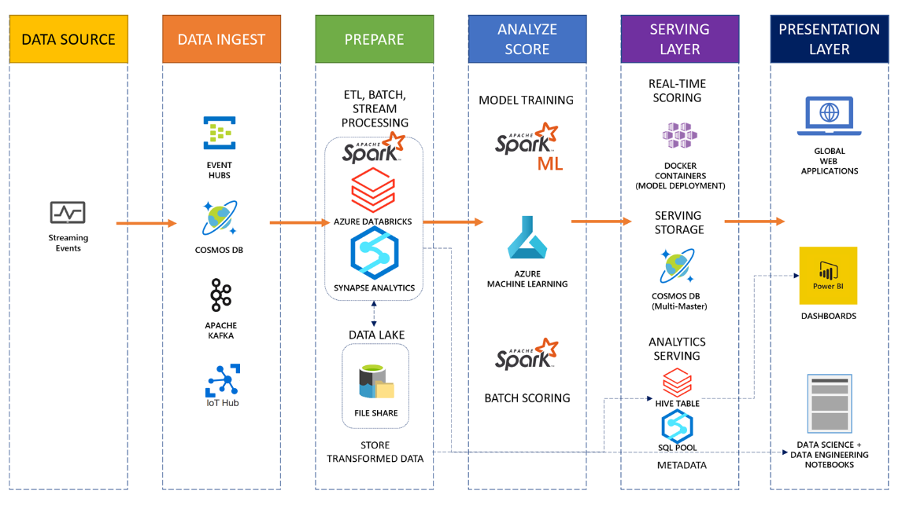
Common scenario

Slide 14
Step 2: Design the solution
Outcome
Design a solution and prepare to present the solution to the target customer audience in a 15-minute chalk-talk format.
Timeframe
60 minutes
Business needs (10 minutes) | Respond to questions outlined in your guide and list the answers on a digital Whiteboard.
Design (35 minutes) | Design a solution for as many of the stated requirements as time allows. Show the solution on a Whiteboard.
Prepare (15 minutes) | Identify any customer needs that are not addressed with the proposed solution. Identify the benefits of your solution. Determine how you will respond to the customer’s objections. Prepare for a 15-minute presentation to the customer.

Slide 15
Step 3: Present the solution
Outcome
Present a solution to the target customer in a 15-minute chalk-talk format.
Timeframe
30 minutes (15 minutes for each team to present and receive feedback)
Directions
Pair with another table.
One table is the Microsoft team and the other table is the customer.
The Microsoft team presents their proposed solution to the customer.
The customer asks one of the objections from the list of objections in the case study.
The Microsoft team responds to the objection.
The customer team gives feedback to the Microsoft team.

Slide 16
Wrap-up
Outcome
Identify the preferred solution for the case study.
Identify solutions designed by other teams.
Timeframe
15 minutes

Slide 17
Supply Chain Optimization
Whiteboard Design Session – Preferred Solution

Slide 18
High Level Architecture
For this solution, you will need to ingest data from multiple sources. Originally, there are 4 sources of truth across five silos. Additionally, there will likely be data that needs to be ingested from devices and other channels as Parts Unlimited builds out their new retail solutions. Using Azure data factory and/or IoT and Event Hubs, bring all the data together into Azure Data lake and Azure Databricks. Then using Synapse analytics, machine learning, and analysis services, generate the final data that will be used in the reports.

Slide 19
Data Ingestion
To get all the data, you will need to be able to ingest data from the various sources that exist as well as potentially respond to devices and other channels, so you'll have Azure Data Factory, an IoT Hub, and potentially an EventHub. You will then likely use other tools to transform the data and filter the results for presentation.

Slide 20
Data Pipeline Processing
Data ingested will be moved from Azure Data Factory to Azure Data Lake storage, where it will be fed into Azure Synapse Analytics Spark tools to analyze and transform the data for presentation. Information from IoT devices and event hub will be moved by Azure Stream Analytics into CosmosDB for analysis in Azure Synapse Analytics services.

Slide 21
Dashboards and Reporting
The dashboards for this solution should allow the marketing team to make sure that personalized recommendations are driving results.

Slide 22
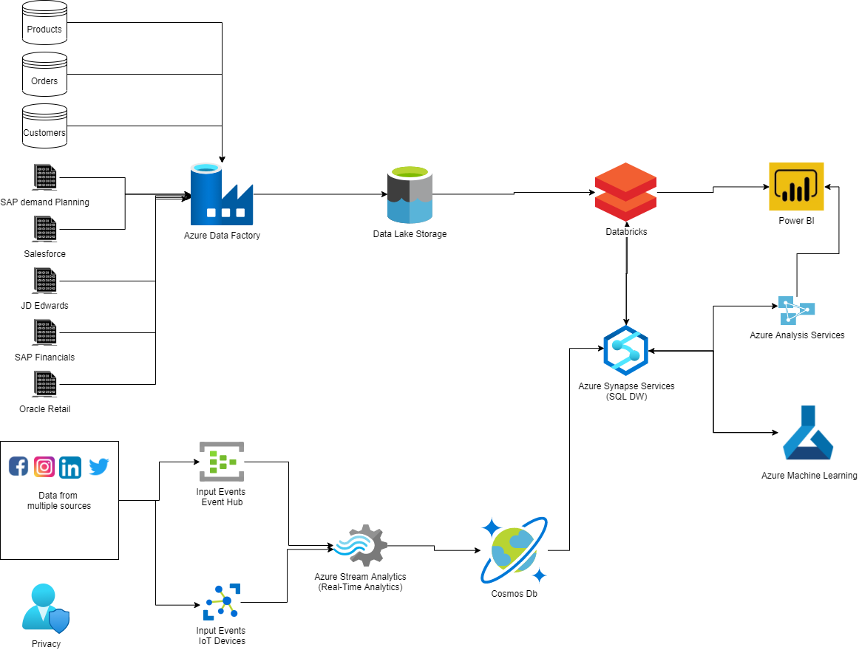
Preferred Solution Architecture diagram

Slide 23
Preferred objections handling #1
Objection
We currently have all the data we need, why do we need to do anything else?
Potential answer
While you currently have all the data, you do not have a solution that allows for all of the analysts to see every part of the data to gain clarity on how the supply chain can be optimized. This solution will provide a 360 degree vision of the entire process so that any analyst can find the information they need from a single source of truth, providing the opportunity to create better results more efficiently, and with a great deal more accuracy.

Slide 24
Preferred objections handling #2
Objection
We've spent a lot of money and time building out the systems we have, we can't just throw it all away and start over.
Potential answer
You won't be throwing anything away. The original reports may be retired, but your new solution will leverage the data that is currently in place. Machine learning and data ingestion and transformation will allow for your solution to garner great results that you simply cannot currently get from the data as your system exists today.

Slide 25
Preferred objections handling #3
Objection
It seems like this is a lot of speculation. How will this solution help us to create a better process for getting our products from suppliers to the warehouses and then to the stores any more quickly than we already do this? People can only plan so fast and trucks won't be able to physically drive any faster while maintaining safety standards.
Potential answer
The solution will help you to optimize this process. While it's true that people can't work any more quickly and trucks can't drive faster than they currently do, having trucks that are fully loaded with the correct products and warehouses that are correctly and efficiently staffed while also having predictive analytics to help ensure you procure the correct products in a timely manner will be where the optimization of the process will excel.

Slide 26
Preferred objections handling #4
Objection
The amount of work and time that it is going to take to implement this is going to be too much. Right now if you change one part of the process the ripple effect could be very significant for the final delivery of the products to the correct stores and/or customers.
Potential answer
This is a legitimate fear. You don't want to make the process worse than it already is. While it's true that sometimes you have to slow down to go fast, we are confident that we can implement a solution quickly that will give you valuable and actionable information that will not only prevent issues with your supply chain, but will ultimately optimize it.

Slide 27
Preferred objections handling #5
Objection
It will be logistically and economically difficult to work with the other departments that are siloed - we can't afford to get our accounting team up to speed on EDI or our EDI team up to speed on customer management.
Potential answer
The great news about this solution is that everyone can still use what they know, but now they will have access to the other data they need. By building out the robust reporting that is necessary, your teams will be able to get the data they are looking for without having to worry about other pieces that currently could cause problems for them. Additionally, since the data is all available in the same system, there won't be any need to learn other processes or wait on other teams to get back to you with results.

Slide 28
Customer Quote
"We are so pleased with the results offered through the provided solution. We have truly achieved a 360 degree view of our supply chain, and we've been able to optimize our warehouse inventory and staffing. We've seen a great reduction on the level of greater than 75% improvement on being able to deliver products and avoid both overstocking and understocking our stores. Customer delivery time is also increased and we now have most deliveries completed within two days of an order being placed"
- Guy Information, CIO, Parts Unlimited Retail

